Slide 1


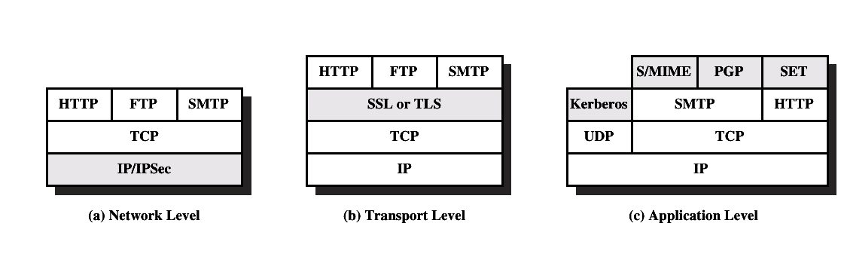
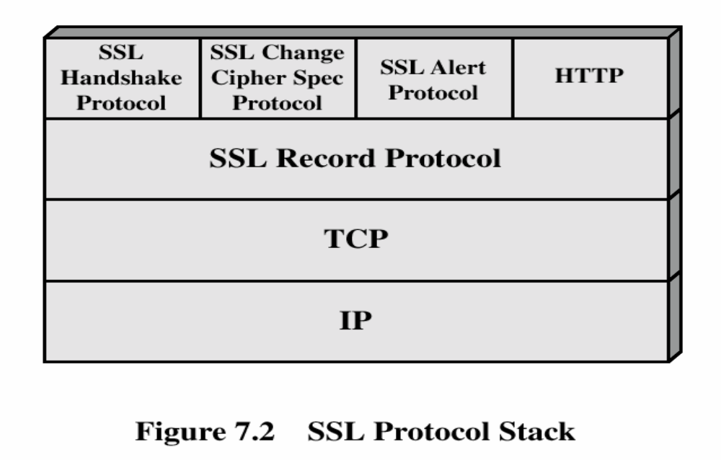
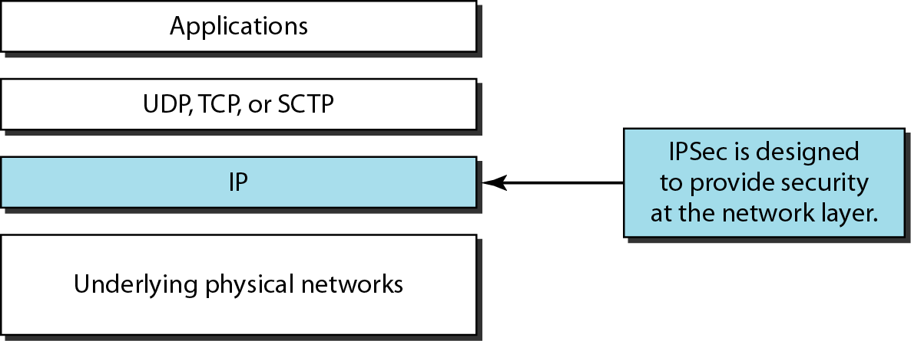
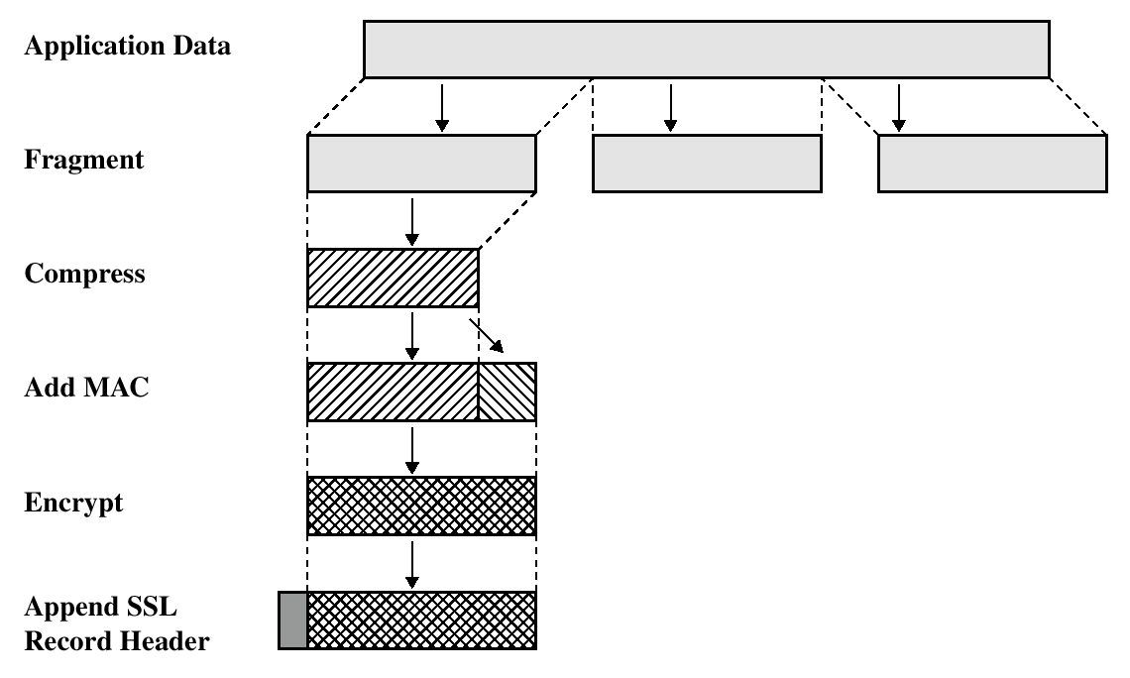
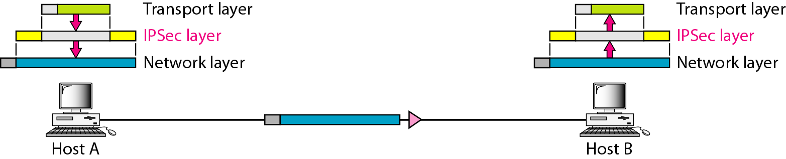
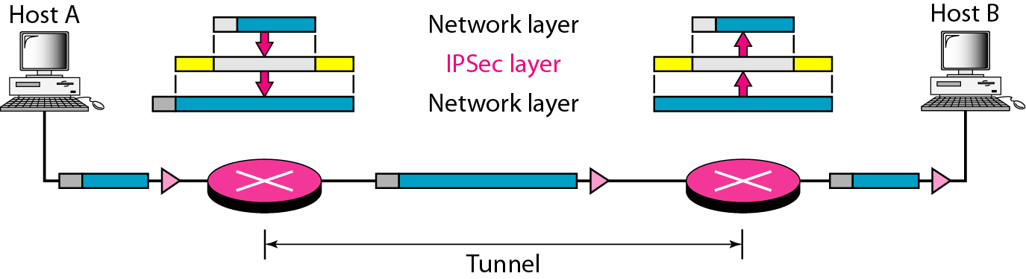
NETWORK SECURITY APPLICATIONS
WEB SECURITY
IP SECURITY
WebSecurity Considerations
  The WEB is very visible.
  Complex software hide many security flaws.
  Web servers are easy to configure and manage.
Users are not aware of the risks.
What is IPSec?
  IPSecurity (IPSec) is a collection of protocols designed by the Internet Engineering Task Force (IETF) to provide security for a packet at the network level.
Secure Socket Layer (SSL)
  SSL was s originated by Netscape
  SSL is designed to make use of TCP to provide reliable end-to-end secure service.
  SSL is not a single layer protocol but rather two layers of protocols.
SSL Architecture
Hand Shake Protocol
The most complex part of SSL.
Allows the server and client to authenticate each other.
Negotiate encryption, MAC algorithm and cryptographic keys.
Used before any application data are transmitted.
Cryptographic Algorithms
HMAC-SHA1 for integrity protection
TripleDES-CBC for confidentiality
AES-CBC for confidentiality
RFC : IP Sec Documents
RFC 2401
RFC2402
RFC2406
RFC2408
SSL Record Protocol Operation
Differences
version number
message authentication code
pseudorandom function
alert codes
cipher suites
client certificate types
certificate_verify and finished message
cryptographic computations
padding
Modes of IPsec
Transport Tunnel
Transport Layer Security
(TLS)
The same record format as the SSL record format.
Defined in RFC 2246.
TLS working group was formed within IETF (Internet Engineering Task Force)
First version of TLS can be viewed as an SSLv3.1
Key Management
  Manual
  Automated
IPSec Services
Networking devices
Operates on the workstation or server
Protection against data changes
Datagram’s Content can be hidden
Names: Maria Shakeel, Musarat, Hanif, Naeem Instructor: Asima Nisar

